Slide 1
IS 120
Intro to Web Dev

Slide 2


Tanner
Instructor
MISM 2, Sandbox
Full-Stack Developer at Zions Bank
Bagpipes, skiing, Legos, and video games

Slide 3
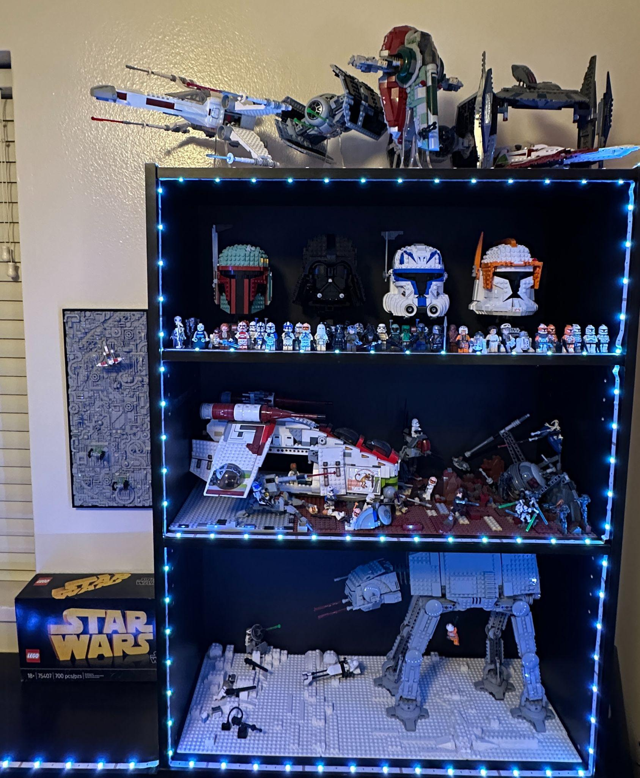
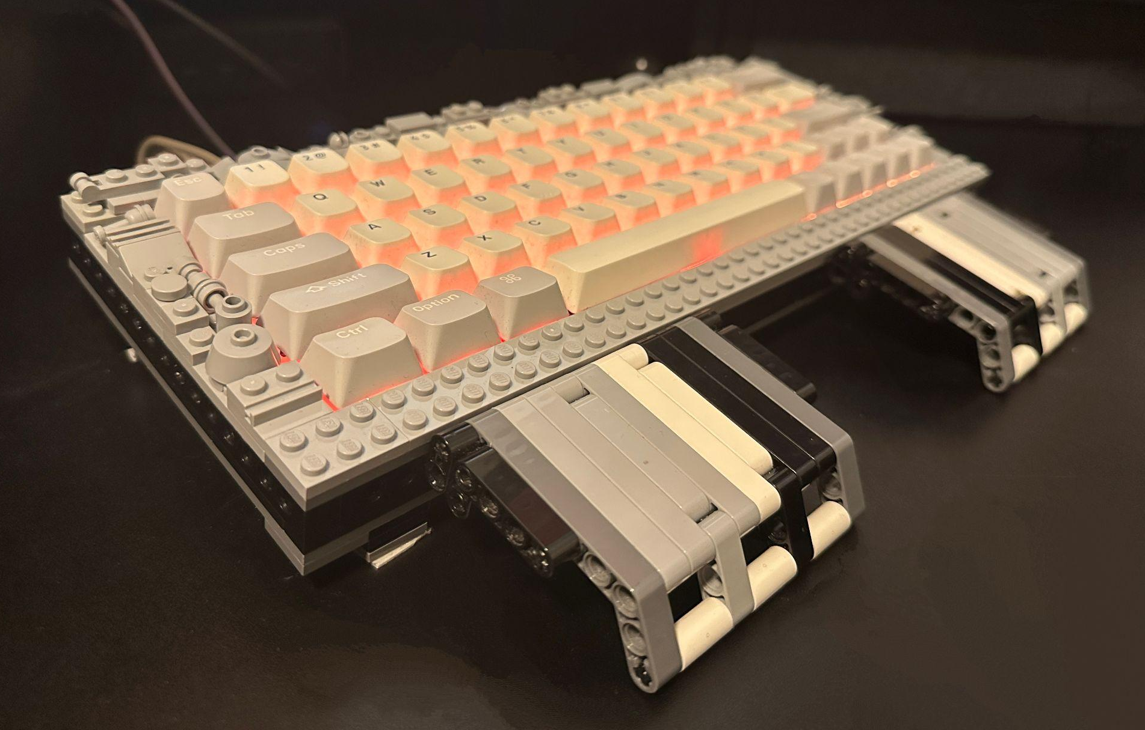

Slide 4

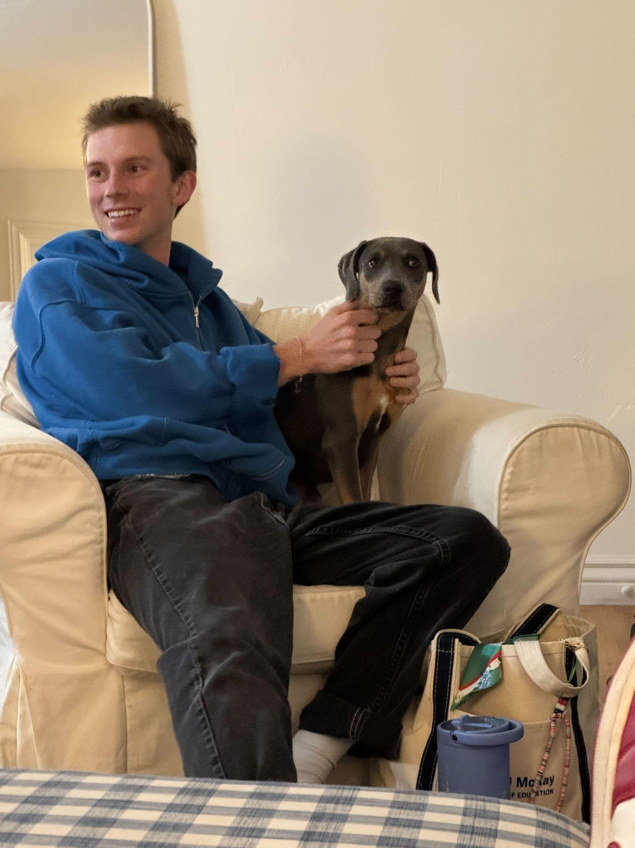
Quade
TA
IS Junior Core
Rock climbing, hiking, and the outdoors

Slide 5
About You
Majors? (Pre-IS, Business, Other)

Slide 6
About You
Majors? (Pre-IS, Business, Other)
Previous classes? (IS 110, IS 201, IS 303)

Slide 7
About You
Majors? (Pre-IS, Business, Other)
Previous classes? (IS 110, IS 201, IS 303)
Previous coding experience? (HTML, CSS, JS, Git/GitHub)

Slide 8
About You
Majors? (Pre-IS, Business, Other)
Previous classes? (IS 110, IS 201, IS 303)
Previous coding experience? (HTML, CSS, JS, Git/GitHub)
Why do you want to take this class?

Slide 9
Course Overview
Introduction to Web Development
Basics of HTML, CSS, JavaScript
How web pages are structured (HTML), styled (CSS), and made dynamic (JS)
This course will be very hands-on and project based

Slide 10
Course Topics
Best practices and current standards for HTML and CSS
How to use version control software like Git/GitHub
CSS layout using display, position, Flexbox, and Grid
Fundamentals of modern responsive web design
CSS design systems and animations
Designing websites with accessibility in mind
Fundamental JavaScript to create interactive websites

Slide 11
Learning Outcomes
Experience what it’s like to be a web developer
Understand how websites work and are structured
Improve problem-solving and debugging skills
Develop a better eye for design
Prepare for the IS Junior Core (Quade)

Slide 12
Grade Breakdown
Late projects and assignments will not be accepted
Lowest assignment will be dropped
2 absences will be dropped at the end of the semester
Assignments | 30%
Projects | 50%
Attendance | 15%
Dev Tool Demo | 5%

Slide 13
How to Succeed in This Class

Slide 14
Think like a Programmer
Understand the problem
Break it down
Just start coding something, even if it’s bad
Try Research
Repeat

Slide 15
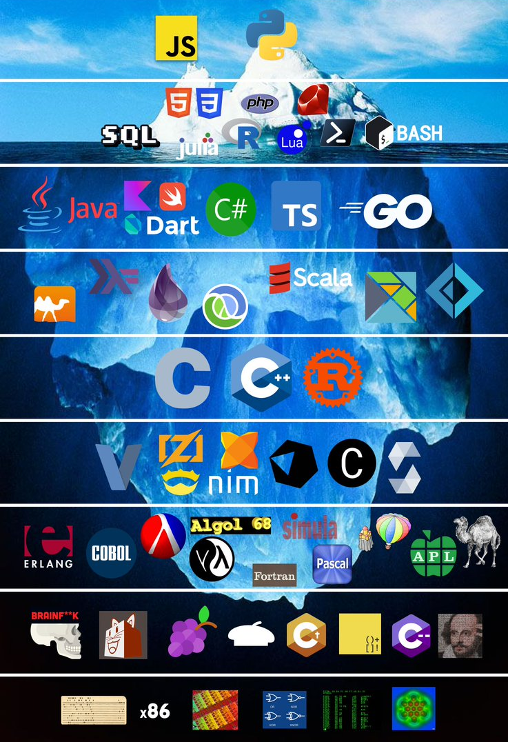
The Web Dev Iceberg
There is always more to learn
Learn to love learning
Don’t get discouraged

Slide 16
Resources
Documentation
MDN Web Docs
W3 Schools
Example Solutions
Stack Overflow
Ask classmates in Slack! (#questions)
  I will literally give you extra credit if you ask or answer questions in Slack. They have to be like legit though.

Slide 17
AI Usage
Experience with AI? (ChatGPT, Loveable, Cursor)

Slide 18
AI Usage
Experience with AI? (ChatGPT, Loveable, Cursor)
AI is a good thing! It’s a great tool

Slide 19
AI Usage
Experience with AI? (ChatGPT, Loveable, Cursor)
AI is a good thing! It’s a great tool
Let AI be a tool, not a crutch

Slide 20
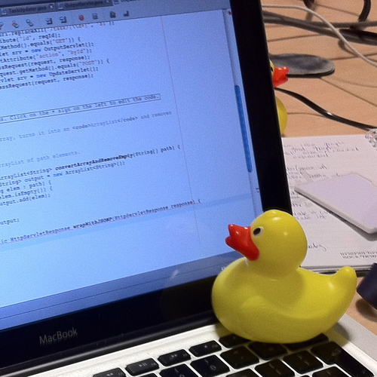
Rubber Ducking

Slide 21
Rubber Ducking
Explaining your programming problem to a rubber duck

Slide 22
Rubber Ducking
Explaining your programming problem to a rubber duck
Let AI be your rubber duck

Slide 23
Rubber Ducking
Explaining your programming problem to a rubber duck
Let AI be your rubber duck
You need to be able to explain your problem clearly

Slide 24
Rubber Ducking
Explaining your programming problem to a rubber duck
Let AI be your rubber duck
You need to be able to explain your problem clearly
PLEASE DO NOT COPY AND PASTE TO OR FROM CHATGPT

Slide 25







Slide 26
Reaching Out for Help
If you get stuck, please, please, please feel free to ask the TA or Instructor for help
We will try to be as available as we can, even outside of office hours
Use Slack

Slide 27
Semester Computer Setup

